Slide 1




FED CUP 2020
Europa/Africa Group I
in Luxembourg

Slide 2

February 5
to
February 8
Centre National de Tennis
(CNT)
Esch/Alzette
Tie Informations

Slide 3
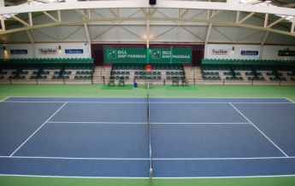
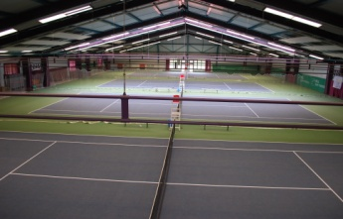
2 courts CENTER COURT and COURT 1

Slide 4
Luxembourg
Poland
Serbia
Slovenia
Sweden
Turkey
6 Teams

Slide 5
Serbia: 21
Poland: 26
Sweden: 29
Turkey: 39
Luxembourg: 44
Slovenia: 49
Nations Ranking

Slide 6
GROUP A
SERBIA
SWEDEN
LUXEMBOURG
GROUP B
POLAND
TURKEY
SLOVENIA
6 Teams
Group A and Group B

Slide 7
LUXEMBOURG
Mandy Minella (WTA 140)
Eléonora Molinaro (WTA 276)
Claudine Schaul
Marie Weckerle
Tiffany Cornelius
Captain: Anne Kremer
LUXEMBOURG

Slide 8
SWEDEN
Rebecca PETERSON (WTA 44)
POLAND
Magda LINETTE (WTA 43) & Iga SWIATEK (WTA 56)
SERBIA
Nina STOJANOVIC (WTA 84)
TURKEY
Cagla BUYUKAKCAY (WTA 174)
SLOVENIA
Tamara ZIDANSEK (WTA 69)
WTA TOP PLAYERS

Slide 9
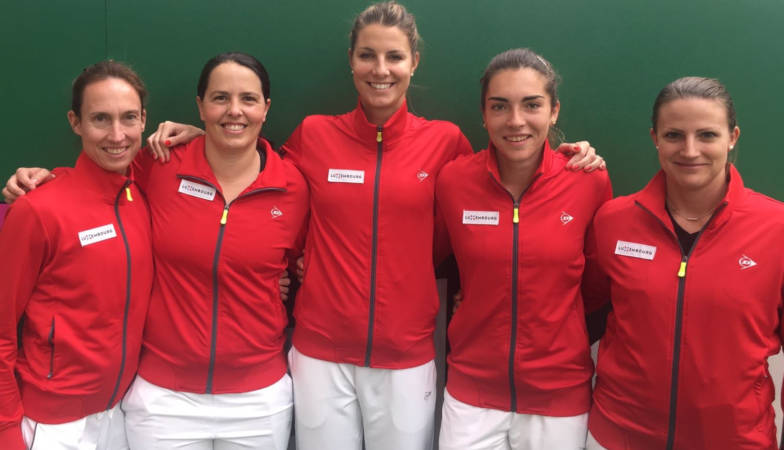
First year played: 1972
Ties played: 151 ( (64 - 87)
Most ties played: Anne Kremer (74)
Most years played:
Anne Kremer (20) & Claudine Schaul (20)
Youngest player:
Eléonora Molinaro (14 years 153 days)
SEAT LUXEMBOURG
FED CUP TEAM

Slide 10
2 pools of 3 teams
Six teams will compete in Esch, across two pools of 3 teams.
The winners of each pool will play-off against the runners-up in the opposite pool to determine which two nations will advance to the Play-offs.
The teams finishing in last place in their pools will play-off to determine which nation is relegated.
Two promoted.
one relegated.

Slide 11
Europa/Africa Group I
two singles
followed by
a double
Fed Cup Format

Slide 12
Europa/Africa Group II
February 5 : 2 international ties in the afternoon (16h)
February 6 : 2 international ties in the afternoon (16h)
February 7 : 2 international ties in the afternoon (15h)
February 8 : Promotional play-off & Relegation play-down
Fed Cup
Schedule

Slide 13
Europa/Africa Group I
15 € per day
50 € subscription package (4 days)
no entrance fee under 16
FLT – Maison des Sports – Strassen
www.flt.lu
Fed Cup Tickets ONLINE

Slide 14

DAVID HAGGERTY ITF PRESIDENT
SPECIAL GUEST

Slide 15

MAIN PARTNERS
TEAM LUXEMBOURG

